Slide 1

IMDB Movie Analysis
NAME :- Shalini Pathak
TRAINITY – Data Analytics Course

Slide 2
ABOUT PROJECT
In this project we are provided with a dataset of imdb_movies which includes several columns like director_name ,duration ,gross ,genres , movie_title ,language , country ,budget ,title_year ,imdb_score etc.
Here, success can be defined by high IMDB ratings. The impact of this problem is significant for movie producers, directors, and investors who want to understand what makes a movie successful to make informed decisions in their future projects.
First we need to clean the data then do several analysis on the dataset inorder to know the duration of movie, different genre of movies, budget used for movie making, different languages of movies etc.
There are several questions asked in this project in order to answer them we need to use excel and statistics functions and formulas.

Slide 3

TASK GIVEN :-
Language Analysis
Movie Duration Analysis
Movie Genre Analysis
Director Analysis
Budget Analysis

Slide 4
A) Movie Genre Analysis
In this we need to determine the most common genre of movie and calculate their descriptive statistics of Imdb score.
We will use excel worksheet and statistics formula.
Formula used are :-
Countif function to count the number of movies for each genre.
Excel functions like ( =Average() , =Median() , =Mode() , =Max() , =Min() ,
=Var() , =Stdev() )
STEP :-
First we need to create a separate column of all the unique values of genre, here we will select one cell and insert a formula ( =Unique(Inside this bracket we need to put the whole range of Genre column) this will give us all unique genres together name this column as “Unique Genre”.
Now we need to know the number of movies for each genre So, use formula ( =Countif((select whole range of genre),(select genre of which you want count of movies from unique genre column) ) this will give as count.

Slide 5
OUTPUT :- https://docs.google.com/spreadsheets/d/1mHXd78BAc9rba2FZlvc986VoE5c4Ha9m/edit?usp=sharing&ouid=116064238907054497678&rtpof=true&sd=true
Now using statistics we need to calculate Imdb score on each genre using formulas of average, median, mode, max, min, variance, standard deviation.
Create a different columns select a cell insert formulas (=Average(whole range of imdb score) ) , in another cell insert (=median(range of imdb score)) , in another cell insert(=mode(range of imdb score)) , in another cell insert(=max(imdb score)) , in another cell insert (=min(imdb score)) , in another cell insert(=var(range of imdb score)) , in another cell insert(=stdev(range of imdb score)).
Hence, now we have the required columns asked use conditional formatting to highlight these columns.

Slide 6
B) Movie Duration Analysis
In this we need to analyze the distribution of movie durations and identify the relation between movie duration and IMDB score.
We need to find the descriptive statistics such as mean , median, and standard deviation
Formula used :- =Average( ) , =Median( ) , =Stdev( )
Now we have to create a scatter plot to visualize the relationship between Imdb score and movie duration and also add the trendline to know the strength of relationship.
STEP :-
We need to use several statistics on movie duration column to find average of duration, median and standard deviation of duration.
In different cells insert formula for Average ( =Average(select whole range of duration column) ) , for Median ( =Median(select whole range of duration column) ) , for Standard Deviation ( =Stdev(select whole range of duration column) ).

Slide 7
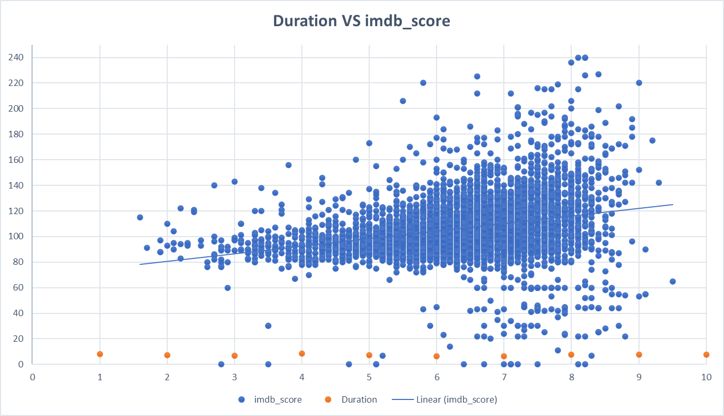

Slide 8
Now we need to identify the relation between movie duration and Imdb score for this we need to insert a scatter plot which will show us all the scattered value of rating Vs duration. Select both the columns of duration and Imdb score and now from insert tab insert a scatter plot graph, this will give us a graph chart of duration Vs Imdb score. And as a result we can see that between time duration 60 – 200 there is maximum number of Imdb score.
OUTPUT :-
https://docs.google.com/spreadsheets/d/1sYEWdb0Hike2OCVHlm4OoeDrSe-f1_kP/edit?usp=sharing&ouid=116064238907054497678&rtpof=true&sd=true

Slide 9
C) Language Analysis
We need to determine the most common languages used in movies and analyze their impact on the IMDB score using statistics.
First we will use the countif function to know the count of languages and then we will use statistics formulas to know the average, median and standard deviation of Imdb score for each language.
Formula used :- =countif( ) , =Mean( ) ,=Median( ) , =Stdev( )
Now compare the statistics to understand the impact of languages on movies ratings.
STEPS :-
First create a new column of “Unique Languages” in cell insert formula ( =Unique( select whole range of language) ) this will give us new unique values of languages.
Now use ( =countif(range of language , specific language) ) function to know the count of movies of each language.
Now we need to use statistical formulas to know imdb score for each language.

Slide 10
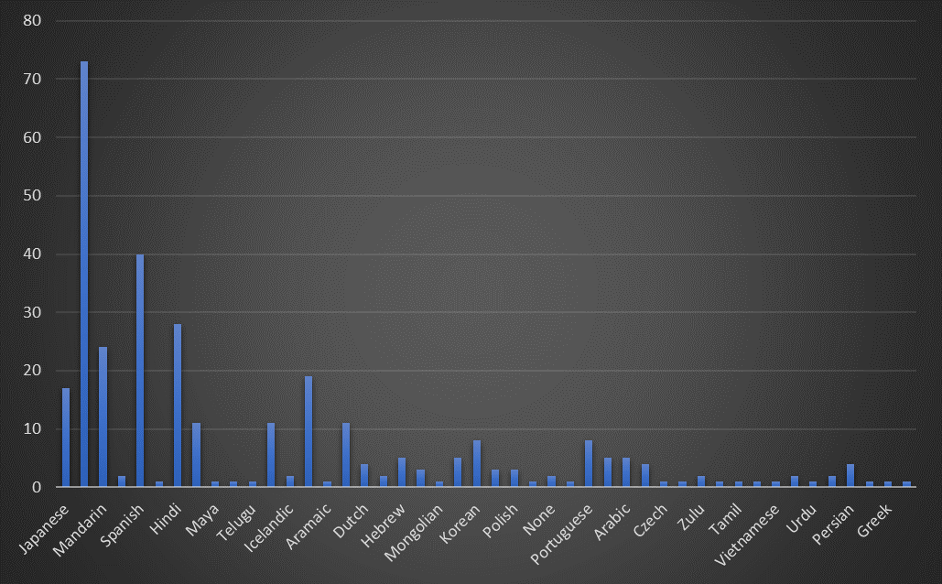

Slide 11
Use ( =Averageifs(O2:O4922,F2:F4922,G2) ) to know the average imdb score of each language where O is imdb score column, F is language column and G2 is specific language from unique language column.
Now we need to calculate median but median cannot contain two range together so we will use if condition, use formula (=Median(IF(F2:F4922=G2,O2:O4922)) where O is imdb score column, F is language column and G2 is specific language from unique language column.
Similarly for standard deviation use ( =STDEV.S(IF(F2:F4922=G2,O2:O4922)) where O is imdb score column, F is language column and G2 is specific language from unique language column.
And now we have all the new columns of Unique language, average , median and standard deviation of imdb score.
OUTPUT :-
https://docs.google.com/spreadsheets/d/1g1XsIes0QIKhEFK0zy9t-HFHoTza1Nnx/edit?usp=sharing&ouid=116064238907054497678&rtpof=true&sd=true

Slide 12
D) Director Analysis
We need to identify top directors based on their average Imdb score and also analyze directors contribution to the success of movies using percentile calculations.
First calculate average Imdb score for each director.
Now use excel percentile function to identify directors with highest score.
Formula Used : - = Average( ) , =Percentile( (range of Imdb score), 0.9 (suppose we
want 90th percentile) )
Compare the top directors score with overall score to know the better success score of movie.
STEP :-
In this we need to first add a column of unique directors so, select a cell and insert formula ( =Unique(range of director column) ).
Now we need the average imdb score of each director so create a column of average imdb score and insert a formula ( =Average(range of imdb score, director name) ).

Slide 13
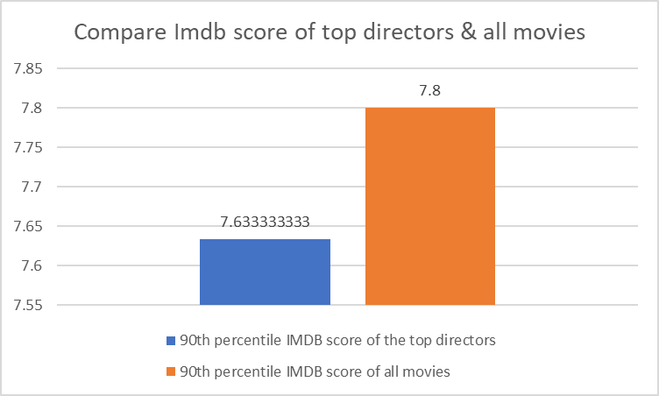

Slide 14
To knoe the percentile score of top directors use formula ( =PERCENTILE(D2:D4922,0.9) ) where D is average imdb score column and I have use 0.9 to know the 90th percentile score if you want to know the 50th percentile score than use 0.5.
Similarly, to know the percentile score of all the movies imdb score use formula
( =PERCENTILE(B:B, 0.9) where B is Imdb score column range.
Now compare both the percentile values, we can see there is not much difference.
OUTPUT :-
https://docs.google.com/spreadsheets/d/10GZeuOuonrLEeS7vcTkLdaeUnvTLRCYv/edit?usp=sharing&ouid=116064238907054497678&rtpof=true&sd=true

Slide 15
E) Budget Analysis
We need to explore the relationship between movie budgets and their financial success.
Here we need to find the success of movie compare to budget means does movie budget is more than the success rate ? Is movie worth a budget. We need to find answers for such questions.
Also find correlation between movie budgets and gross earnings.
Formula used :-
To calculate Profit Margin = Gross earnings – Budget.
To find Correlation use =Correl( (budget) , (Gross) ).
Find the Highest profit margin using =Max( ).
STEP :-
Here we are going to use two columns of gross and budget and we will add new column of Profit Margin, now select a cell and insert a formula ( =Gross – Budget ) this will give as profit margin.

Slide 16
To maximum number of profit margin use formula ( =max( select profit margin column)).
Now find the correlation between budget and gross add a column and select a cell and insert a formula ( =Correl(budget, gross) ).
If we want to find the name of movie with maximum number of profit margin we can use index formula , insert index function where first select whole range of movie titles than using a match function select maximum profit margin than select whole range of profit margin and at last put 0 to know the true value.
Now if the movie title matches the max profit margin from the whole profit margin then it will provide as the name of movie as True value formula ( =Index( range of movie title, Match(max(profit margin),profit margin, 0))
OUTPUT :-
https://docs.google.com/spreadsheets/d/1gcZtXUt4UlBkExBJQlH0SqS7FqIcC3VU/edit?usp=sharing&ouid=116064238907054497678&rtpof=true&sd=true

Slide 17
Thank you!

